Slide 1
FoodHub Project
Python Foundations – Business Analysis
Bowen Wilder 2024-05-31

Slide 2
Contents / Agenda
Executive Summary
Business Problem Overview and Solution Approach
Data Overview
EDA - Univariate Analysis
EDA - Multivariate Analysis
Appendix

Slide 3
Executive Summary
Please mention conclusions, actionable insights & recommendations
Please add the answer for question 17
Note: You can use more than one slide if needed

Slide 4
Business Problem Overview and Solution Approach
Please define the problem
Please mention the solution approach / methodology
Note: You can use more than one slide if needed

Slide 5
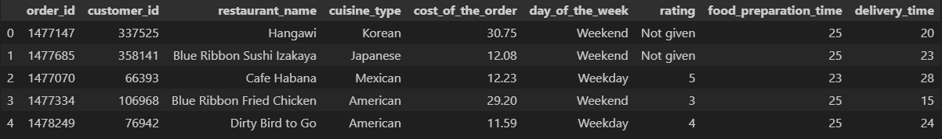
Shape of the Dataset
There are 1,898 ROWS in the dataset
There are 9 COLUMNS in the dataset
Sample

Slide 6
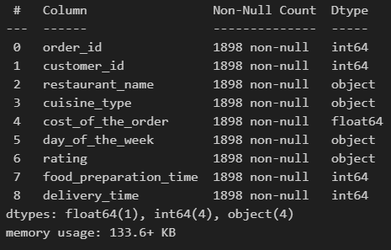
Dataset Column Datatypes
Integers:
order_id,
customer_id,
food_preparation_time
Strings:
restaurant_name,
cuisine_type,
day_of_the_week,
rating
Floats:
cost_of_the_order

Slide 7
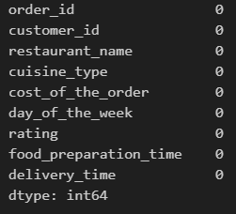
Dataset Missing Values
There are no missing values in the dataset

Slide 8
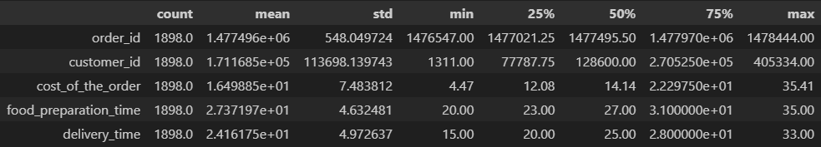
Dataset Statistical Summary
Food Preparation Minimum time: 20 minutes
Food Preparation Mean time: 27.37 minutes
Food Preparation Maximum time: 35 minutes
order_id and customer_id are categorical values therefore their statistical summary is not very helpful or necessary

Slide 9
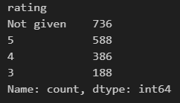
Unrated Orders
736 order ratings were not provided by customers that used the service

Slide 10
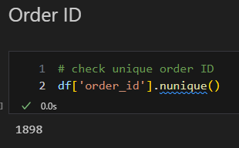
Univariate Analysis: Order ID
FoodHub completed 1,898 unique orders. One for every row in the dataset.

Slide 11
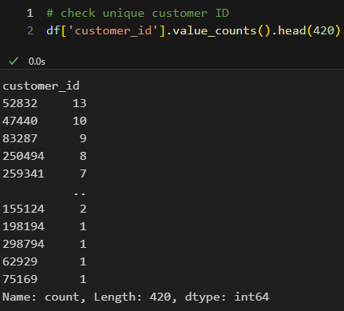
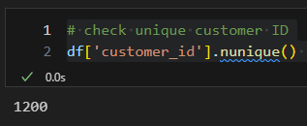
Univariate Analysis: Customer ID
FoodHub captured 1,200 unique customer ids.
416 Customers ordered more than once from the service

Slide 12
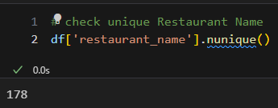
Univariate Analysis: Restaurant Name
There are 178 unique restaurant names in the dataset

Slide 13
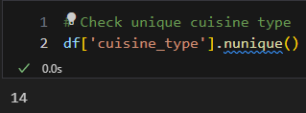
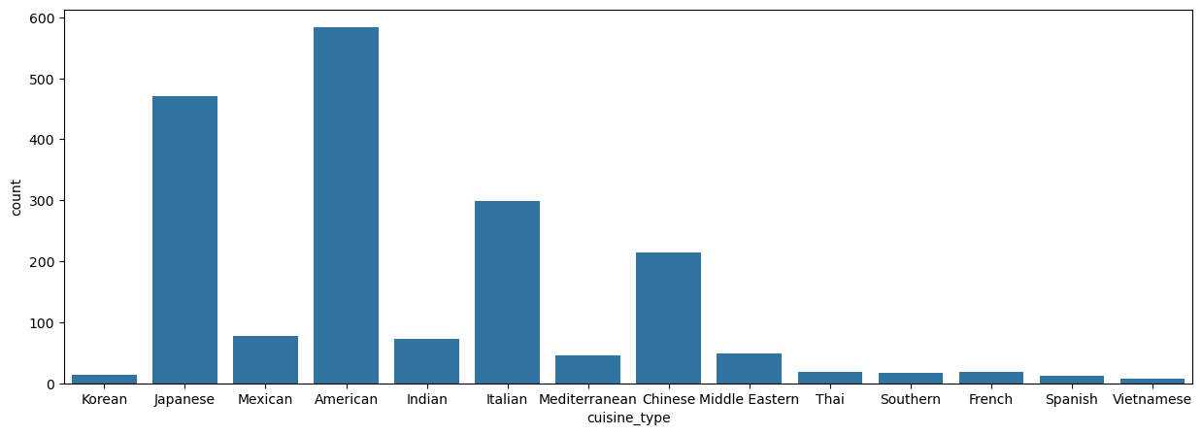
Univariate Analysis: Cuisine Type
There are 14 unique cuisine types

Slide 14
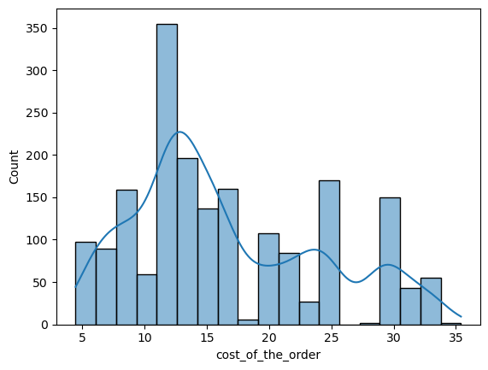
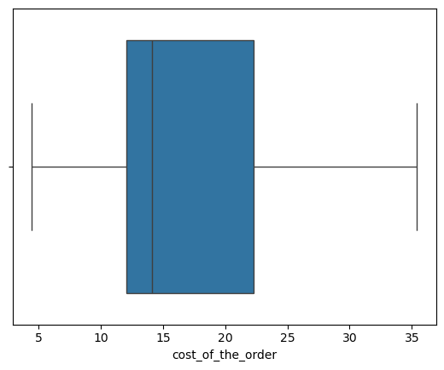
Univariate Analysis: Cost of the Order

Slide 15
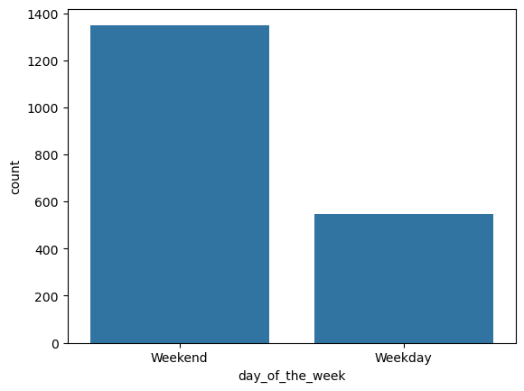

Univariate Analysis: Day of the Week
There are only 2 unique values in the day_of_the_week column

Slide 16
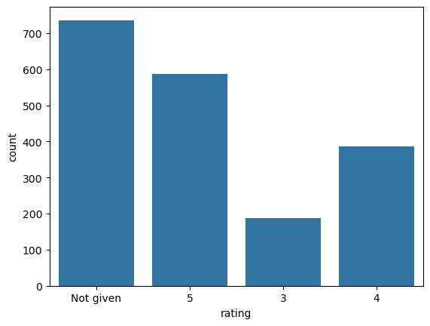
Univariate Analysis: Rating
Many customers chose not to leave a rating at all

Slide 17
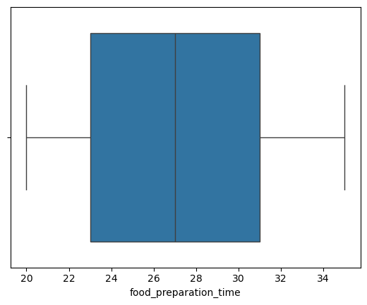
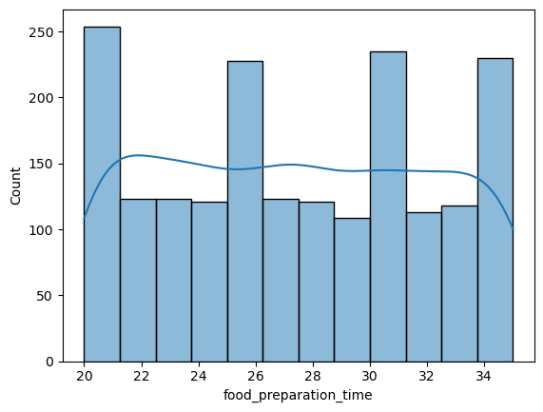
Univariate Analysis: Food Preparation Time

Slide 18
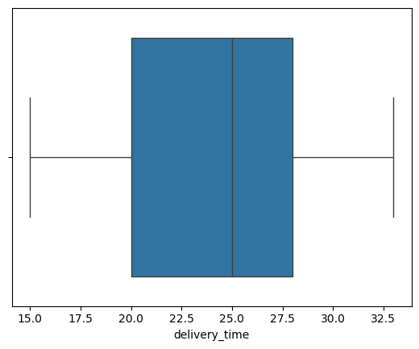
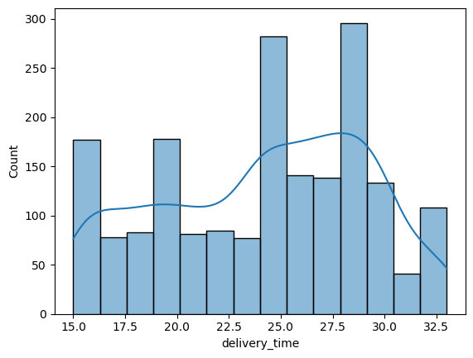
Univariate Analysis: Delivery Time

Slide 19
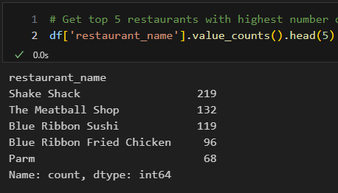
Univariate Analysis: Top 5 Restaurants by Number of Orders Received

Slide 20
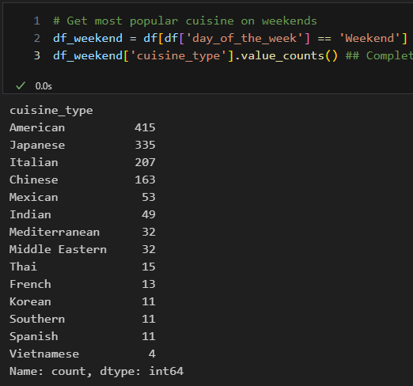
Univariate Analysis: Most Popular Weekend Cuisines
American cuisine is most popular on the weekends

Slide 21
Univariate Analysis: Percentage of Orders Greater than $20
The number of total orders that cost above 20 dollars is: 555
Percentage of orders above 20 dollars: 29.24 %

Slide 22
Univariate Analysis: Delivery Order Mean Time
The mean delivery time for this dataset is 24.16 minutes

Slide 23
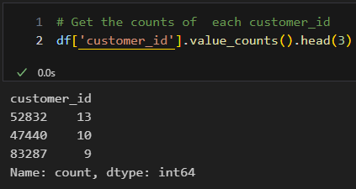
Univariate Analysis: Most Frequent Customers Discount

Slide 24
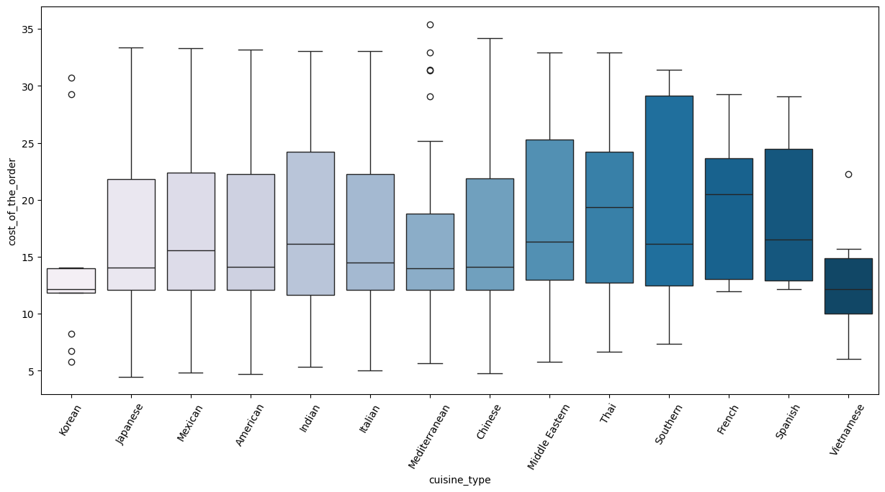
Multivariate Analysis: Cuisine v. Cost of Order

Slide 25
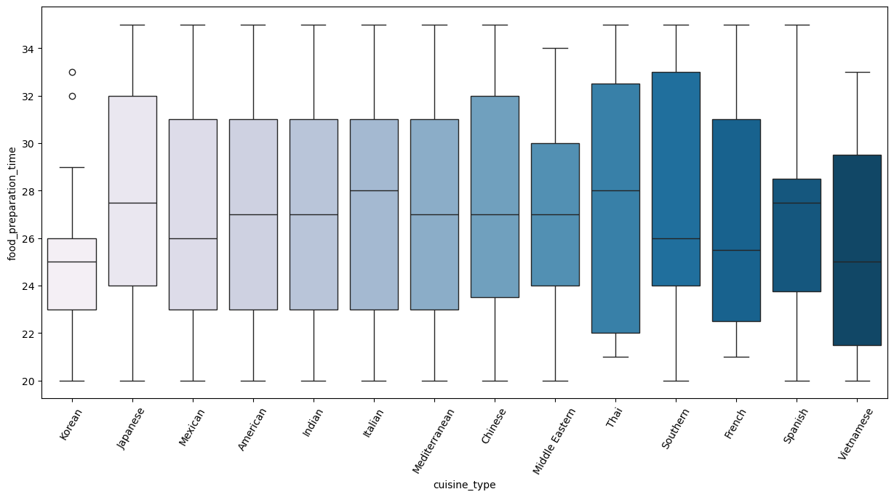
Multivariate Analysis: Cuisine v. Food Preparation Time

Slide 26
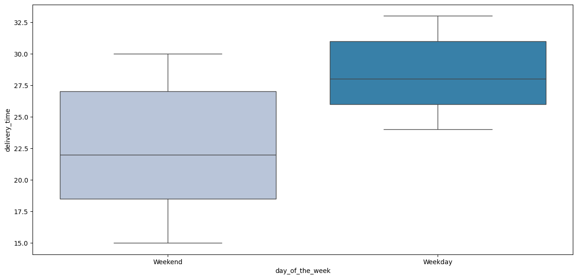
Multivariate Analysis: Day of Week v. Delivery Time

Slide 27
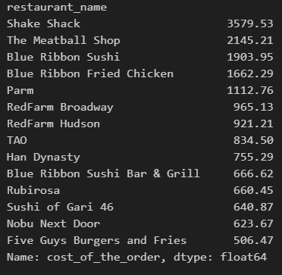
Multivariate Analysis: Revenue by Restaurant

Slide 28
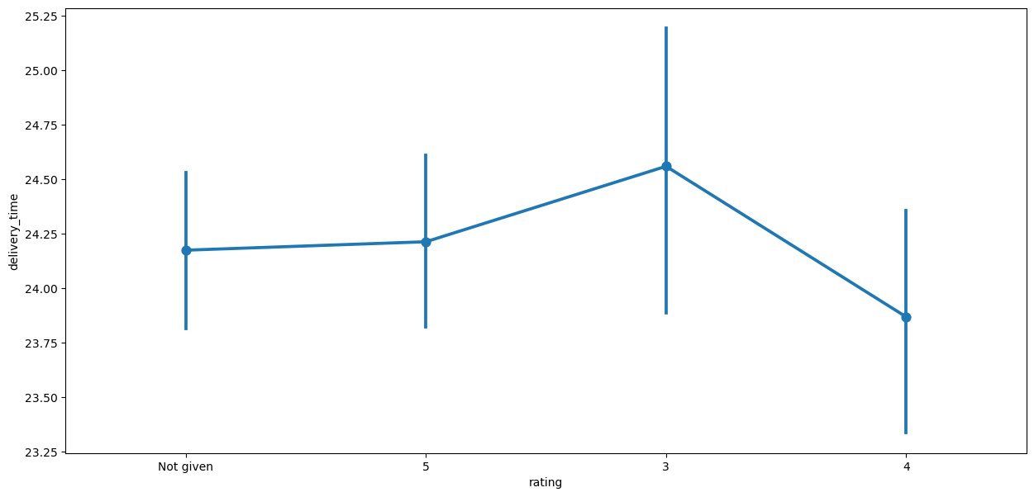
Multivariate Analysis: Rating v. Delivery Time

Slide 29
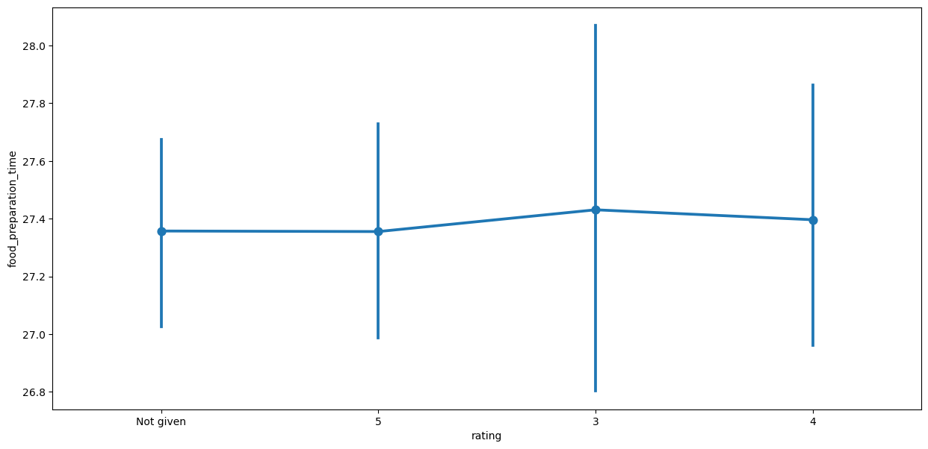
Multivariate Analysis: Rating v. Food Preparation Time

Slide 30
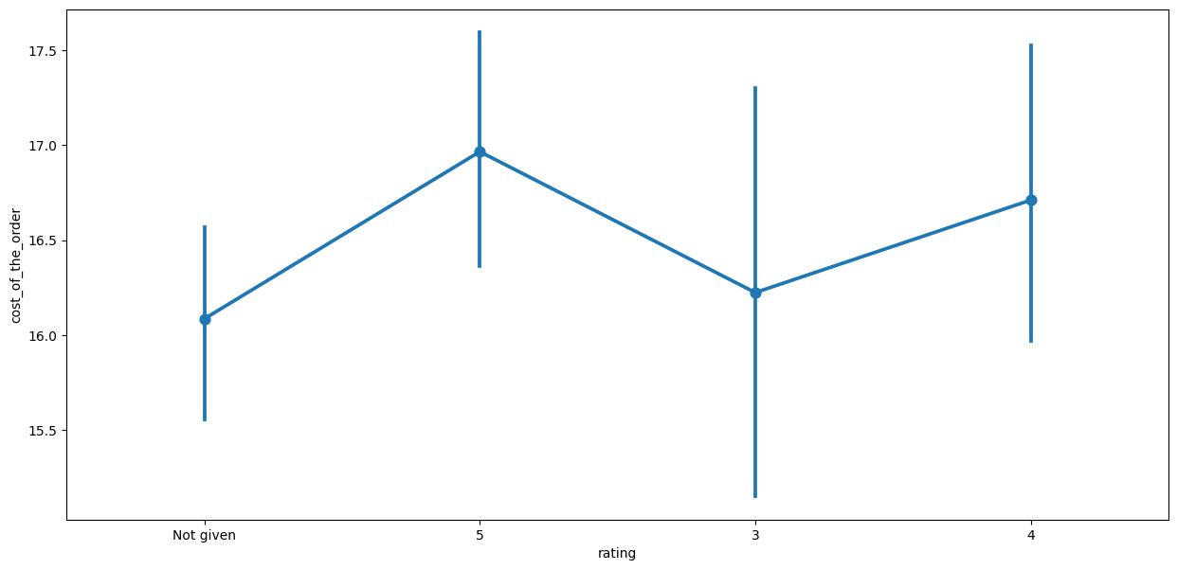
Multivariate Analysis: Rating v. Cost of Order

Slide 31
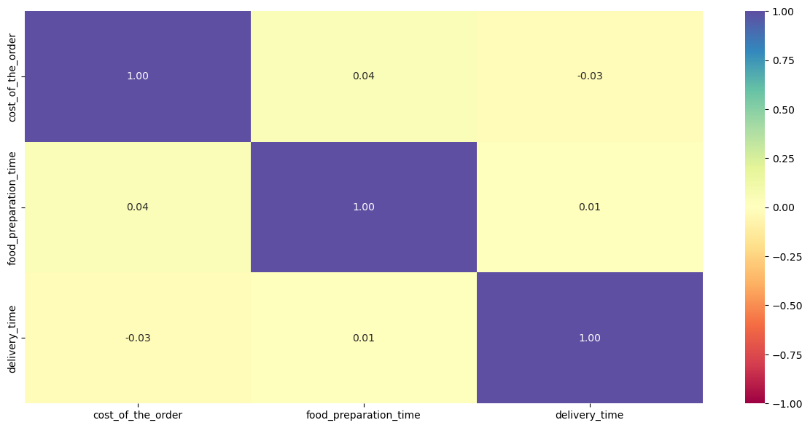
Multivariate Analysis: Numeric Variable Correlations

Slide 32
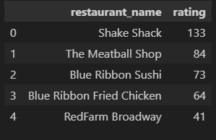
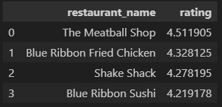
Multivariate Analysis: Promotional Offer
FoodHub wants to provide a promotional offer in the advertisement of the restaurants. The condition to get the offer is that the restaurants must have a rating count of more than 50 and the average rating should be greater than 4

Slide 33
Multivariate Analysis: Net Revenue
The net revenue is around 31,314.82 dollars

Slide 34
Multivariate Analysis: Total Delivery Time
The number of orders where the total time is greater than 60 min is: 1898
Percentage of orders that have more than 60 minutes of total delivery time is: 100.0 %

Slide 35
Multivariate Analysis: Delivery Time (Weekend v. Weekday)
The mean delivery time on weekdays is around 28 minutes
The mean delivery time on weekends is around 22 minutes

Slide 36
Conclusions
Customer Preferences and Patterns:
The most popular cuisine type is American, followed by Japanese and Italian. These three cuisines account for the majority of the orders.
Less popular cuisines include Vietnamese, Spanish, and Korean.
Order Cost Analysis:
The average cost of an order is approximately $16.50, with a standard deviation of $7.48.
Most orders (75%) cost between $4.47 and $22.30, with the highest cost recorded at $35.41.
Time Analysis:
The average food preparation time is approximately 27.37 minutes, with a standard deviation of 4.63 minutes.
The average delivery time is approximately 24.16 minutes, with a standard deviation of 4.97 minutes.
There is a notable difference in delivery times between weekdays (average 28.34 minutes) and weekends (average 22.47 minutes).
Rating Insights:
A significant number of orders (736) have no rating provided.
Of the orders that have ratings, the majority are rated 5 or 4.
The highest average ratings are observed in cuisines like Chinese and Japanese.

Slide 37
Reccomendations
Data-Driven Decisions:
Continuously monitor and analyze customer preferences and operational metrics to adapt to changing trends and demands.
Use the data to inform strategic decisions, such as menu adjustments, pricing strategies, and marketing initiatives.
Optimize Resources:
Allocate resources effectively based on the data, ensuring adequate staffing during peak times and efficient use of delivery personnel.
Implement technology solutions, such as route optimization software, to enhance delivery efficiency.
Customer Engagement:
Engage with customers through personalized offers based on their order history and preferences.
Implement loyalty programs to retain customers and encourage repeat orders.
Continuous Monitoring:
Set benchmarks and goals for improvement in these areas, and review progress regularly to ensure continuous operational excellence.
Regularly track key performance indicators (KPIs) such as preparation time, delivery time, and customer ratings.

